Slide 1
A Method for Malware Analysis by Virtual Machine Introspection Technique
The presentation was made by students of group 6111
Shtengauer Kirill and Shelashnikov Timofey

Slide 2
Table of Contents
1. Introduction
2. Problem Definition
3. Description of the method and introduction of concepts
3.1. Virtual Machine Monitor
3.2. Types of Virtual Machine Monitor
3.3. VirtualBox Hypervisor
3.4. Virtual Machine Introspection
3.5. Design of the Method
4. Experiment
4.1 The principle of the experiment
4.2 Experimental Results
5. Conclusion

Slide 3
Introduction
Malicious code has become one of the biggest threats in the field of computer security, the number of malware has grown in recent years
Traditional malware monitoring tools are installed in the physical host, however, they are vulnerable to being infected by malware and delivering erroneous results about monitoring

Slide 4
Problem Definition
Traditional monitoring tools have become too vulnerable and unprotected for malware attacks
Our goal is to propose and experimentally test a malware monitoring method based on the virtual machine introspection method, which allows you to obtain a virtual machine memory image from the outside

Slide 5
Virtual Machine Monitor
Virtual Machine Monitor (VMM) or hypervisor is a software that enables communication between Virtual Machines and real host
It provides the virtual environment by means of a Virtual Machine where other programs can be executed just as they do in a real environment

Slide 6
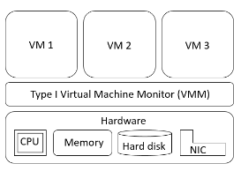
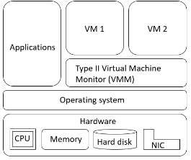
Types of Virtual Machine Monitor
Type I Virtual Machine Monitor
Type I VMM is one that runs directly on the hardware, they are used in data centers and in server environment
The type II VMM is installed on the operating system of the real host as another user program
Type II Virtual Machine Monitor

Slide 7
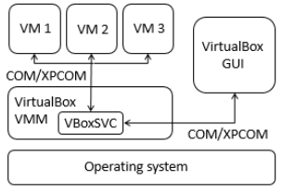
VirtualBox Hypervisor
The approach proposed is based in one of the type II VMM that is called VirtualBox. It provides a main API that is implemented using the Component Object Model, an interprocess mechanism for software components
Architecture of VirtualBox

Slide 8
Virtual Machine Introspection
Virtual Machine Introspection is a technique to analyze the memory of a given VM to detect its internal activities from outside over the Virtual Machine Monitor layer
This technique has been used for intrusion detection, malware analysis and memory forensics

Slide 9
Design of the Method
The virtual machine introspection method consists of the following five steps:
Access to the asset: This is achieved using an interprocess mechanism called COM/XPCOM
Collection: It generates a memory dump of the Virtual Machine volatile memory
Analysis: The program converts low-level bytes into high-level information and extracts objects from the operating system
Logging: It generates the log of the malware analysis
Containment: The COM/XPCOM interprocess mechanism sends a killing command to finish the malware execution from outside the Virtual Machine

Slide 10
The principle of the experiment
In order to test the operation and functioning of the approach, three experiments were performed, each of them consisted in the execution of a different sample of malware inside the monitored Virtual Machine
Experiment | Malware | MD5 | Antivirus detection from VirusTotal
1 | Trojan | 7583a73f73638d23298ddb4900def643 | 56/64
2 | Trojan | 8915452ee0b8e754ee7b047a849a01a2 | 58/68
3 | Trojan | c334b788e3da78c413364ef1e163b8ff | 43/68
Main characteristics of malware samples.

Slide 11
Experimental Results
In the first experiment the introduced malware executed 7 threads, 4 network connections and 24 open files
In the second experiment 5 threads, 1 network connection and 21 open files were registered
The last experiment consisted in the execution of the third sample of malware, which was associated with the creation of 1 thread, 1 network connection and 12 open files
Experiment | Malware | #Threads | Network connections |  | # Open files | Suspicious files
 |  |  | Port | Address
1 | Trojan | 7 | 8143 | 199.7.136.88 | 24 | ws2_32.dll, ws2help.dll, mswsock.dll, dnsapi.dll, 996E.exe.
 |  |  |  | 151.80.142.33
 |  |  | 1743
 |  |  |  | 202.69.40.173
 |  |  | 243
 |  |  |  | 78.47.66.169
 |  |  | 7447
2 | Trojan | 5 | 1029 | 0.0.0.0 | 21 | wsock32.dll, ws2_32.dll, crypt32.dll
3 | Trojan | 1 | 80 | 211.104.175.45 | 12 | ws2_32.dll, mswsock.dll, wshtcpip.dll, rpcrt4.dll,
Results reported by the reporting module

Slide 12
Conclusions
By analyzing the virtual machine memory image, the behavior of three malware samples in the virtual machine was obtained, such as their IDs, the IDs of their parent processes, the number of threads, as well as their network connections and open files
Thus, the experimental results confirm the hypothesis that malware can be identified using the virtual machine introspection method

Slide 13
Thank you for your attention

